Slide 1


APIGEE

Slide 2











Digital Channels and Apigee Edge
Mobile
ESB, SOA,
App Servers,
Databases
Point of Sale
App, API, Analytics Infrastructure
Partner
Backend Services
Web
Apps

Slide 3
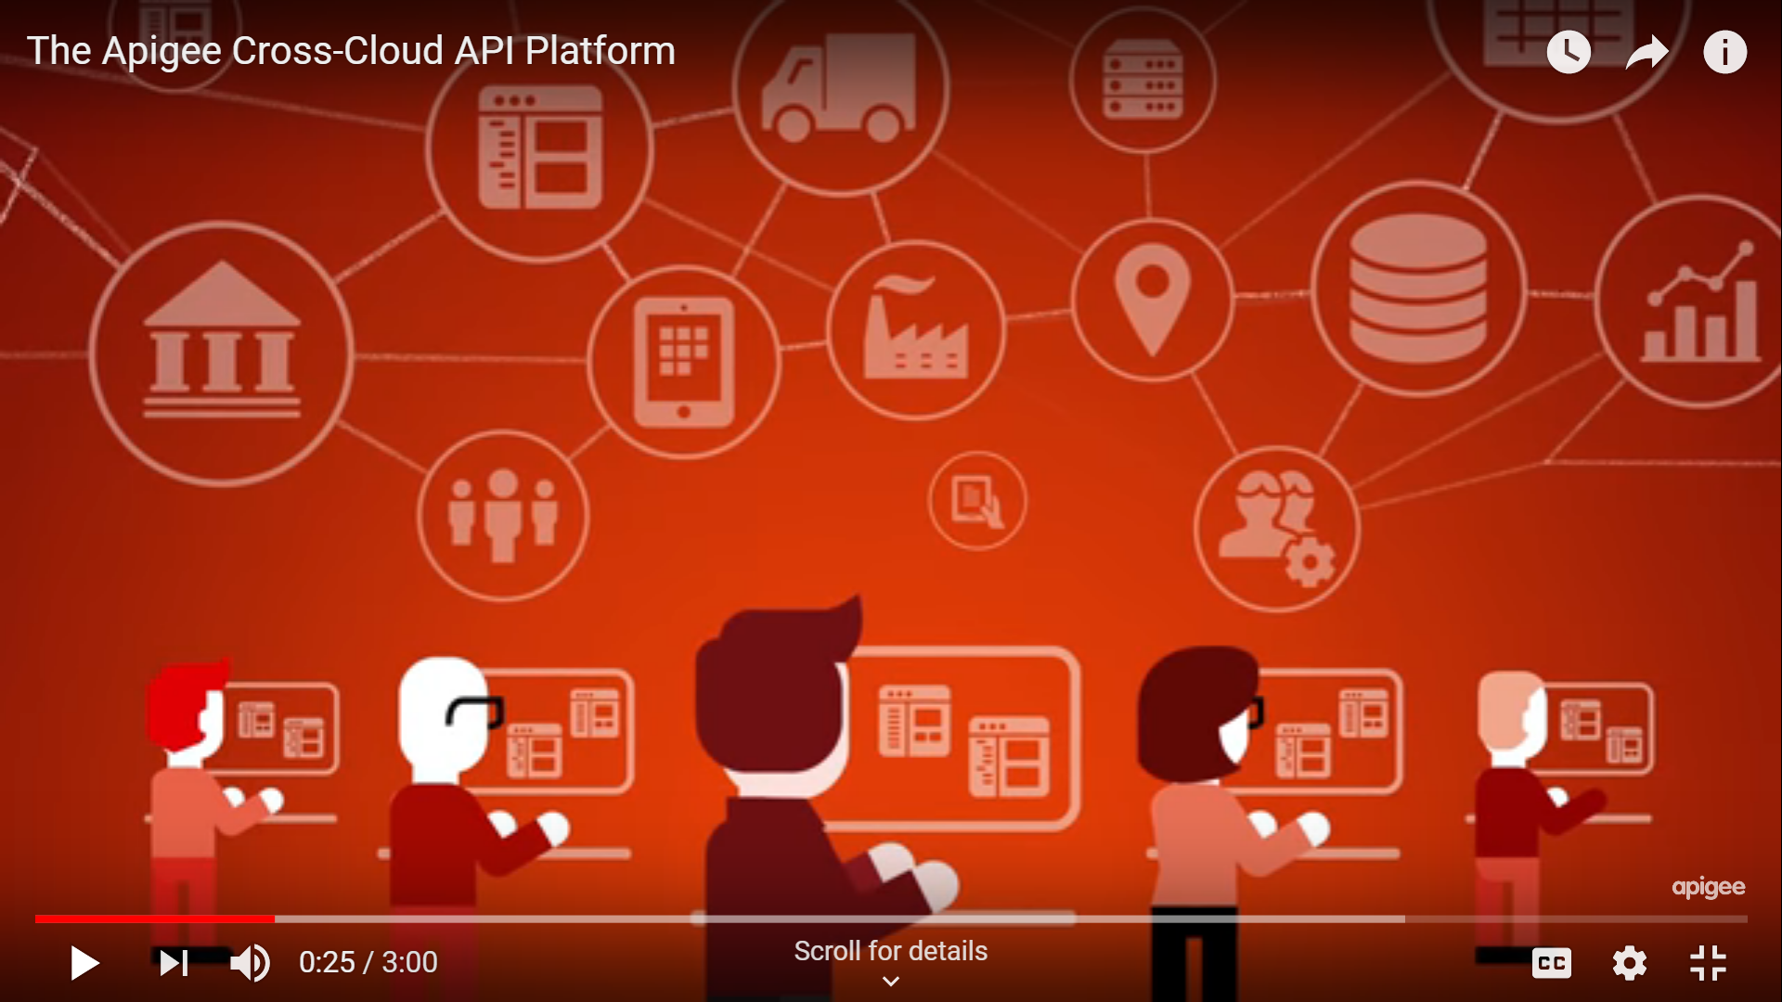
Digital Channels and Apigee Edge

Slide 4
APIGEE Goals
Concepts and Configuration
API Proxies
Build API Proxies
Features of APIGEE Gateway
Design of API Proxy
User Developer Platform
User Management
Logging

Slide 5
APIGEE Goals
Apigee Analytics
Web Services

Slide 6
Creating an account
Step 1: Create an Apigee account
To use Apigee Edge, you need an Apigee account.
In this step, you'll create a free evaluation account.
To create your evaluation account and log in:
Go to https://login.apigee.com/sign_up.
Enter your name, email address, and a password. Be sure to read and accept the terms of service.
Click Create account.
Apigee sends you an account confirmation.

Slide 7
Creating an account
In the confirmation email, click the account verification link.
You'll be sent to the login page: https://login.apigee.com/login
Log in with the email and password that you used to sign up.
Apigee activates your new account. This can take several minutes.

Slide 8
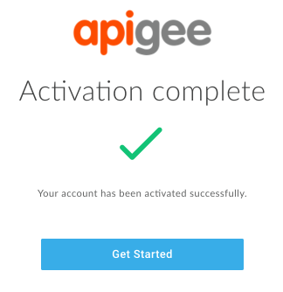
Creating an account
After your account is activated, the following message displays:

Slide 9
A word about organizations
An organization is a container for your API proxies and the environments you deploy them to (either "test" or "prod"). You use the organization name in your calls to the API proxies.
The name of the organization is autogenerated by Apigee based on your email address (minus the @domain). For evaluation accounts, it will end with "-eval".
If necessary, Apigee adds a 5-digit random number to the organization name to ensure that it's unique. For example, if your email address is ahamilton@example.com, the organization name might be auto-generated as "ahamilton-eval" or "ahamilton-12345-eval".

Slide 10
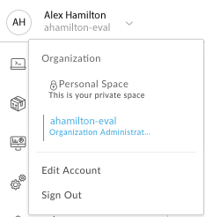
A word about organizations

Slide 11
API Attacks

Slide 12
Layered Security

Slide 13
Signs of Attack

Slide 14
What is an API?
An API is an interface that makes it easy for one application to 'consume' capabilities or data from another application.
By defining stable, simplified entry points to application logic and data, APIs enable developers to easily access and reuse application logic built by other developers.
In the case of 'Web APIs', that logic and data is exposed over the network.

Slide 15
What is an API?
Since applications that consume APIs are sensitive to changes, APIs also imply a 'contract'. The contract provides some level of assurance that, over time, the API will change in a predictable manner.
Apigee Edge enables you to build APIs and if you have APIs already, expose them directly, while adding a management and visibility layer. If you have HTTP enabled services, such as SOA-based Web services, they can also be exposed as APIs via Apigee Edge.
Edge also enables you to build APIs by implementing applications hosted on the API Services platform--with no backend service involved. You can build these applications in JavaScript, Java, and on Node.js.

Slide 16
API Management
API management is the process of
creating and publishing APIs
enforcing their usage policies
controlling access
nurturing the subscriber community
collecting and analyzing usage statistics.

Slide 17



Apps, APIs and API Mgmt…
Apps = Customer facing systems of engagement (Ex: mobile app, web app, etc)
APIs = Exposes assets that developers use to create Apps
App Developer
APIs
API Management = Capabilities needed by enterprises to extend APIs to developers, partners and communities.
Business Owner
IT
Enterprise

Slide 18








Apps, APIs and API Mgmt…
Apps = Customer facing systems of engagement (Ex: mobile app, web app, etc)
APIs = Exposes assets that developers use to create Apps
App Developer
APIs
API Management = Capabilities needed by enterprises to extend APIs to developers, partners and communities.
Business Owner
IT
Enterprise

Slide 19













Apps, APIs and API Mgmt…
Security
Global Deployment
Transformation
Traffic Management
Monetization
Reporting and Monitoring
Mobile Optimization
API Documentation
Partner Customization
Developer Authentication
Versioning

Slide 20









Apps, APIs and API Mgmt…
Benefits
New business opportunities
New markets
Increase customers
Enhance branding
Competitive advantage
Extend development team
Increase innovation
Increase scale
Partner/supplier
alignment
Consumers
Challenges
Business strategy
Infrastructure
Security
Creation
Scalability
Operational control
Publish
Analyze
Monitor
Developer
Business Owner
IT

Slide 21

Business use case
Financial Services: Leading Payments Processor
Business Challenge
Solution
Result
Create an “easy to do business with” environment for partners
Establish a secure digital wallet for online purchases so personal financial data is not transmitted on the internet.
Provide a 360°view of the end user for member banks
Implement an API Management solution that provides:
An easy to use developer portal
Rapid assembly of new Restful APIs for online merchants
Extensive real-time analytics
Improved relationships with members and partners
Increased transaction volumes and revenue generation
Gained real-time views of buying behavior and accelerated the timing of new, targeted offers to buyers
Types of APIs
Example Apps
Coupon redemption
Payment options
Partner Loyalty Programs
Account status
Groupon: Daily Merchant coupons to help drive new customers
PayPal: Account linkage to banks, credit and debit cards
Tripit Point Tracker: aggregates points from various travel industry merchants.
Notes:
This is a use case that covers banks, payment processors, wireless telecommunications, merchants and their supply chain partners. Electronic wallets are getting significant airplay that falls in line with the growth of smart phones. Particularly with customers under 35, they rarely leave any location without taking their phone. Using phones for financial transactions using Near Field Communication (NFC) is growing and the pace will quicken in 2014. API Management provides a secure environment for transactions to take place and includes near real time analytics to understand what is going on with the transactions. To help generate new applications from internal, partner or independent developers, a branded, easy to use developer portal is included.
21

Slide 22
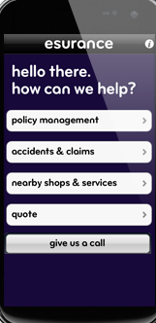

Business use case
Insurance: Leading Property & Casualty Insurance Firm
Business Challenge
Solution
Result
Streamline claims processing for cost reduction.
Improve customer satisfaction by speeding up claim resolution.
Grow customer base.
Implement an API Management solution that provides:
Exposes customer policy information on mobile devices
Enable claims adjustors to include images of claim to verify damage estimate.
Include select repair partners to exchange data for fast resloution.
Eliminated paper based claims and reduced processing time by 3 days
Customers had the option of having the claim check direct deposited to their banking account.
Overall Customer Satisfaction rating improved significantly and then used as central marketing theme.
Types of APIs
Example Apps
Customer policy coverage access
Multimedia uploads to claim form
Repair estimate data exchange with select partners
Direct deposit banking approval
Google Maps: for directions once on the ground
Tripit: for aggregating travel information
Pizza Hut: food ordering and payment processing
Notes:
Most insurers are trying to find ways to streamline their claims processing and reduce their operational costs. By using APIs the insurance company can enable more effective self service options for its policy holders. Using mobile phones with cameras, GPS and a smart app, a motorist can take pictures of the car immediately after an accident, capture the image of the other drivers license and insurance information, initiate a claim form include the associated the GPS coordinates along with the images of the scene. Additionally, a tow truck could be summoned as well as a taxi or rental car. All done with a set of APIs and a new business process. API Management provides a secure environment for transactions to take place and includes near real time analytics to understand what is going on with the transactions. To help generate new applications from internal, partner or independent developers, a branded, easy to use developer portal is included.
22

Slide 23
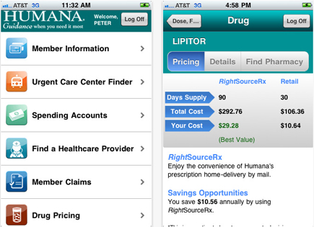
Business use case
Healthcare: Leading Healthcare Provider
Business Challenge
Solution
Result
Allow patients, physicians and medical personnel secure multi-channel access to patient data including:
Appointments
Insurance coverage
Prescription refills
Patient/physician email
Implement an API Management solution that provides:
A secure/encrypted environment for maintaining and transmitting sensitive patient data
An easy to use developer portal
Rapid assembly of new APIs to access legacy applications without extensive app rewrite.
Released new REST enabled applications for mobile devices in under 90 days.
Created reusable APIs for pretreatment authorization from multiple insurance carriers
Provided patients a mobile app to refill prescriptions via mobile devices.
Types of APIs
Example Apps
Appointment book access
Insurance coverage requests
Pharmacy order entry
Secure messaging/email
Merck Medicus: Patient handouts
Greenway PrimeMOBILE: Electronic Health Record access
BC/BS NC: HealthNAV, provides an urgent care finder
WellDoc Diabetes Manager: connecting patient readings with physicians
Notes:
Managing healthcare data today requires strict adherence to a large and growing number of regulations while at the same time dealing with reduced fees from insurers, Medicare/Medicaid (or other governmental agency) and increasing costs of equipment, training and personnel. With APIs, healthcare professionals can exchange critical patient data to reduce the time for diagnosis, treatment and rehabilitation. API Management provides a secure and encrypted capability to protect sensitive patient data, and ensures it is consumed by only authorized personnel. Connections to pharmacies, testing centers and therapy facilities are handled by the APIs to provide a seamless environment to improve patient care and control costs.
23

Slide 24

Business use case
Energy & Utilities: Leading Electric Utility
Business Challenge
Solution
Result
Improve the efficiency of energy consumption across consumer, commercial and industrial customers.
Increase utilization of self-service portal to reduce operational costs
Reduce power outage time caused by extraordinary events.
Implement an API Management solution that provides:
A secure/encrypted environment for transmitting usage data to demand systems and models.
An easy to use developer portal
Extensive real-time analytics to better understand customer behavior and payment patterns
Launched multichannel app to monitor and control energy usage
Increased use o self-service portal by 15% resulting in operational cost savings of 3%
Improved response and power restoration time by mashing up location data of repair teams and outage failure point.
Types of APIs
Example Apps
Energy consumption & management
Service requests including new service, repair, and rate management
Location services for mobile repair teams
Inventory management for field repair depots and teams
MobileIron SmartHome: remote control of home electrical devices
Southern California Edison: customer support for service transfer.
Scottish Power XDA repair centre.
Notes:
Energy usage and costs continue to increase for all types of customers. Finding ways to better manage the available power and restore it following an outage can lead to lower consumption and monthly bills as well as improved customer service when get the lights turned on again. Providing a mobile smart app to control heating and cooling systems in homes, commercial and industrial buildings can enable users to manage their usage and take advantage of lower prices during off peak periods. Also for repair crews, having apps that give precise GPS coordinates for power outages, and better control of “in the field” inventory of repair parts, can speed the best equipped repair team to the site and restore the power more quickly. API Management provides a secure environment for transactions to take place and includes near real time analytics to understand what is going on with the transactions. To help generate new applications from internal, partner or independent developers, a branded, easy to use developer portal is included.
24

Slide 25


Business use case
Automotive: Leading Automobile Manufacturer
Business Challenge
Solution
Result
Create additional sticky services for auto owners
Expand the ecosystem for dealers and partners including road service and hospitality brands.
Generate higher dealer traffic volume
Implement an API Management solution that provides:
A secure messaging environment between the auto manufacturer and the partners.
An easy to use developer portal
Extensive real-time analytics to better understand customer behavior and usage patterns
Launched new service utilizing sensor data from the car, GPS coordinates and roadside service stations to minimize breakdowns and locate nearby repair facilities.
Generated multiple customer testimonials that helped increase dealer traffic by 8%
Types of APIs
Example Apps
Location based services
Sensor data to warranty systems
Alerts to dealers
Service record access
Google Maps: GPS location mapping
GM OnStar: vehicle diagnostics online monitoring while you drive
BMW Connected Drive: intelligent emergency call for assistance
Notes:
In today’s automobiles is not uncommon to find 4,000 sensors capturing data to feed the onboard processing elements. GPS devices are now standard in most new cars and with onboard wireless technologies, the vehicles of today are rolling computers with robust communications capabilities. When coupled with other data sources providing weather, road congestion and emergency response vehicles, the APIs providing easy access to this information can provide drivers with near real time data to shorten their commute, avoid accident sites or even report a problem as it is happening. The API Mgt. system protects against denial of service attacks, routes key messages to the appropriate destination, manages the message flow so the backend systems are not overloaded and monitors the effectiveness of the system to ensure compliance with SLAs.
25

Slide 26

Business use case
Telecom: Leading Wireless Carrier
Business Challenge
Solution
Result
Establish a secure digital wallet for subscribers
Create ecosystem for Near Field Communication (NFC) transactions including banks and merchants
Leverage existing loyalty programs
Implement an API Management solution that provides:
An easy to use developer portal
Rapid assembly of new Restful APIs for merchants to access transaction data
Extensive real-time analytics to better understand customer behavior
Launched new service with “sticky” application generating more ARPU
Gained a closer relationship with subscribers and merchants
Provided real-time views of buying behavior and accelerated the timing of new, targeted offers to buyers via loyalty programs
Types of APIs
Example Apps
Payment options (credit/debit)
Partner Loyalty Programs
Merchant specific promotions
Access to payment account information
Groupon: Daily Merchant coupons to help drive new customers
PayPal: Account linkage to banks, credit and debit cards
Tripit Point Tracker: aggregates points from various travel industry merchants.
Notes:
This is a use case that covers banks, payment processors, wireless telecommunications, merchants and their supply chain partners. Electronic wallets are getting significant airplay that falls in line with the growth of smart phones. Particularly with customers under 35, they rarely leave any location without taking their phone. Using it for financial transactions using Near Field Communication (NFC) is growing and the pace will quicken in 2014. API Management provides a secure environment for transactions to take place and includes near real time analytics to understand what is going on with the transactions. To help generate new applications from internal, partner or independent developers, a branded, easy to use developer portal is included.
26

Slide 27


Business use case
Media & Entertainment: Leading Movie Producer
Business Challenge
Solution
Result
Manage partner ecosystem leading up to major a movie release
Control ticket distribution for selected premier venues
Effectively manage IT infrastructure for cyclical demand loads
Implement an API Management solution that provides:
An easy to use and access developer portal for partners
Traffic management to control demand for access to ticket outlets
Scalable cloud based infrastructure to meet demand
Launched new developer portal for partners to add tie in promotions for new movie releases
Smoothed message traffic and incorporated a tiered access program for high value customers
Augmented an on premise implementation with on-demand cloud expansion as needed.
Types of APIs
Example Apps
Ticket purchase
Product placement promotions
Access to sound track recordings
Tiered access (i.e. gold, silver, bronze etc.)
Moviefone pre-release ticket ordering
ComingSoon.net: movie trailers and latest news on stars
Sony Pictures Brand Placement on YouTube, webpages etc.
Notes:
Blockbuster movies, games, and concerts generate significant interest from consumers and the key players on the producer side are looking for a major return on their investment. APIs can help provide access to seat inventory, special ticket promotions, early access to new games/programs etc. They can also provide the tie-ins for loyalty programs as well as product placement promotions. Connecting partner assets/programs helps all these players generate new revenue streams, improved customer satisfaction and more intense loyalty alignment. API Management provides a secure environment for transactions to take place and includes near real time analytics to understand what is going on with the transactions. To help generate new applications from internal, partner or independent developers, a branded, easy to use developer portal is included.
27

Slide 28

Business use case
Banking: Leading Commercial Bank
Business Challenge
Solution
Result
Establish a secure digital wallet for consumer banking customers
Create ecosystem for partners including global credit card companies and merchants
Leverage international brand loyalty programs
Implement an API Management solution that provides:
A secure/encrypted environment for maintaining and transmitting sensitive card holder data
An easy to use developer portal
Extensive real-time analytics to better understand customer behavior and payment patterns
Launched new service maintaining multiple payment options
Increased use and revenue from branded debit and credit cards
Provided real-time views of buying behavior and accelerated the timing of new, targeted offers to buyers via bank and merchant loyalty programs
Types of APIs
Example Apps
Payment options (credit/debit)
Partner Loyalty Programs
Bank and merchant specific promotions
Access to banking account information
PayPal: Account linkage to banks, credit and debit cards
Tripit Point Tracker: aggregates points from various travel industry loyalty programs.
PasKey Mobile banking (Monte Dei Pashi Di Siena) account access.
Notes:
This is a use case that covers banks, payment processors, wireless telecommunications, merchants and their supply chain partners. Electronic wallets are getting significant airplay that falls in line with the growth of smart phones. Particularly with customers under 35, they rarely leave any location without taking their phone. Using it for financial transactions using Near Field Communication (NFC) is growing and the pace will quicken in 2014. API Management provides a secure environment for transactions to take place and includes near real time analytics to understand what is going on with the transactions. To help generate new applications from internal, partner or independent developers, a branded, easy to use developer portal is included.
28

Slide 29
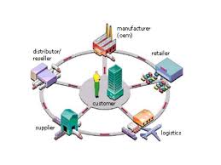
Business use case
Aerospace & Defense: Supply Chain
Business Challenge
Solution
Result
Streamline procurement process when on-boarding new trading partners
Minimize reliance on VANs (Value Added Networks) to reduce costs
Maintain accurate real-time location and inventory usage data.
Implement an API Management solution that provides:
A secure/encrypted environment for maintaining and transmitting sensitive purchasing data
An easy to use developer portal
Extensive real-time analytics to better understand location and usage patterns
Eliminated need for sending and receiving purchase order and invoice documents for new vendors
Provided catalog access and “shopping cart” order process
Generated extensive analytics tracking individual products for location, shelf life and consumption statistics.
Types of APIs
Example Apps
Payment options
Catalog/inventory availability
RFID location based services
Shopping cart services
Tiered access
Amazon shopping cart
IBM® Emptoris® for supplier on-boarding and qualification
PINC Solutions Real Time Location Systems for GPS enabled RFID asset tracking
Notes:
For the past 30+ years, organizations have been looking to technology to streamline their supply chain process, reduce delivery times and lower their cost of goods and services. API Management is a key enabler to help achieve these objectives by making organizations easy to do business with. Eliminating many of the proprietary environments in place (VANs, Hubs, special e-commerce connections and protocols), API Management facilitate easy on-boarding of new trading partners, smoothing and monitoring of the traffic, and can provide deeper analytics in near real time which can translate into better decision making.
29

Slide 30

Retail: Leading Electronics Retailer
Business use case
Business Challenge
Solution
Result
High cost of sale due to reliance on retail stores
No participation in external, web-based /mobile markets
Limited access to customers in locations without store-fronts
Publish APIs targeting content aggregation providers
Increased revenue via participation in external markets
Increased profitability by closing under-performing stores
Established differentiation in external markets by providing same day fulfillment (via storefronts)
Types of APIs
Example Apps
Product catalog
Price list
Inventory by location
Store location
C-Net: Content aggregation for electronics reviews/pricing
Amazon: Electronic store-front
ShopSavvy: Mobile app for price-comparison
Notes:
For small retail organizations, it is often easier to align themselves with a large aggregator such as Amazon or C-Net for order fulfillment rather than adding an e-commerce site to their web presence. The pull of Amazon eliminates the need to attract shoppers to a small, unknown shop in anytown USA. By implementing the API Management solution, an aggregator can expose inventory and pricing information from it fulfillment partners, connect to payment providers and add shipment tracking capabilities allowing the customer an easy to use method of shopping on line.
30

Slide 31

Business use case
Government: Business License Bureau
Business Challenge
Solution
Result
Create a multi-channel business license application process
Reduce the steps and shorten the time process the application
Ensure license renewals are executed on time.
Implement an API Management solution that provides:
A secure/encrypted environment for maintaining and transmitting sensitive applicant data
An easy to use developer portal for accessing legacy systems during the approval process
Analytics for measuring usage
Launched new license application portal that automatically populated forms during the approval process
Automated the insurance verification process required for license issuance
Reduced the time to process by 15% and minimized applicant clerical data input by 45%
Types of APIs
Example Apps
Access to variety of legacy systems inlcuding:
Building permits
Food and liquor licenses
Neighborhood variances
Fire inspections
Property and casualty insurance verification
Chicago Business Affairs: License application and zoning guide
New York City Restoration Permits: post Hurricane Sandy rebuilding
Slate.com link to TerraEarth observatory showing Moore, OK after EF5 tornado
Notes:
Governments at all levels are trying to provide more services, with fewer human resources and less budget across the board. To bridge this widening gap, many organizations are providing more self service capabilities to improve the quality, reduce the manual steps and decrease the time necessary to meet the citizen’s needs. APIs enable a multi-channel access to these services, connect multiple partners and counter parties in an environment that invites developers to extend the limited internal resources of many government entities. Access to open data (i.e. weather, info from other government organizations) is another major initiative that government clients are looking to leverage. API Management provides a secure environment for transactions to take place and includes near real time analytics to understand what is going on with the transactions. To help generate new applications from internal, partner or independent developers, a branded, easy to use developer portal is included.
31

Slide 32
API Management Vendors
3scale
Apigee
Axway
CA Technologies
IBM
Informatica
Intel Services
MuleSoft
SOA Software
Tibco Software
Tyk Technologies
WSO2

Slide 33
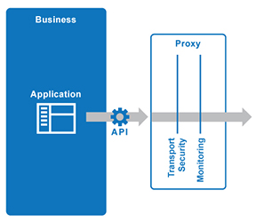
What is an API proxy?
You expose APIs on Apigee Edge by implementing API proxies.
API proxies decouple the app-facing API from your backend services, shielding those apps from backend code changes.
As you make backend changes to your services, apps continue to call the same API without any interruption.

Slide 34
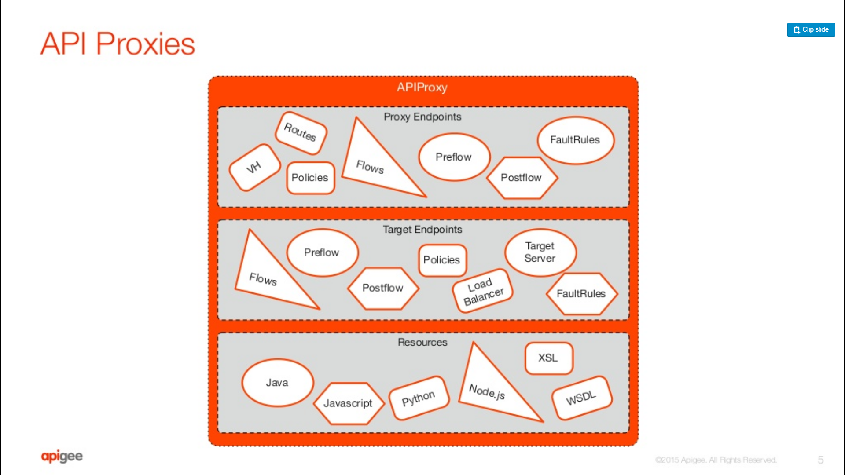

Slide 35
What is an API proxy?
In an API proxy configuration, there are two types of endpoints:
ProxyEndpoint: Defines the way client apps consume your APIs.
You configure the ProxyEndpoint to define the URL of your API proxy.
The proxy endpoint also determines whether apps access the API proxy over HTTP or HTTPS.
You usually attach policies to the ProxyEndpoint to enforce security, quota checks, and other types of access control and rate-limiting.

Slide 36
What is an API proxy?
TargetEndpoint: Defines the way the API proxy interacts with your backend services.
You configure the TargetEndpoint to forward requests to the proper backend service, including defining any security settings, HTTP or HTTPS protocol, and other connection information.
You can attach policies to the TargetEndpoint to ensure that response messages are properly formatted for the app that made the initial request.

Slide 37
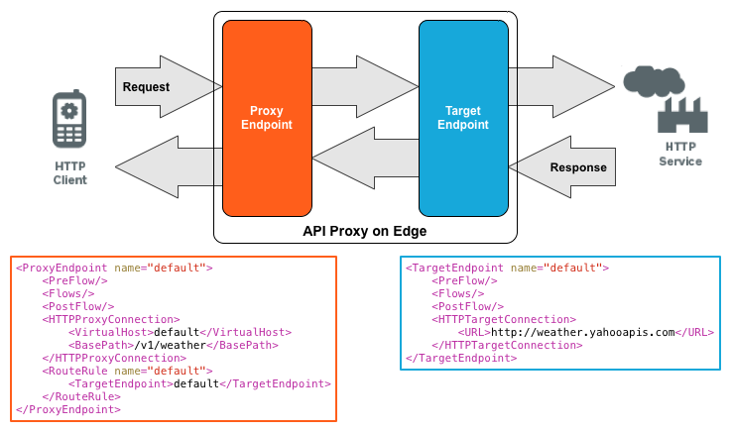
What is an API proxy?

Slide 38
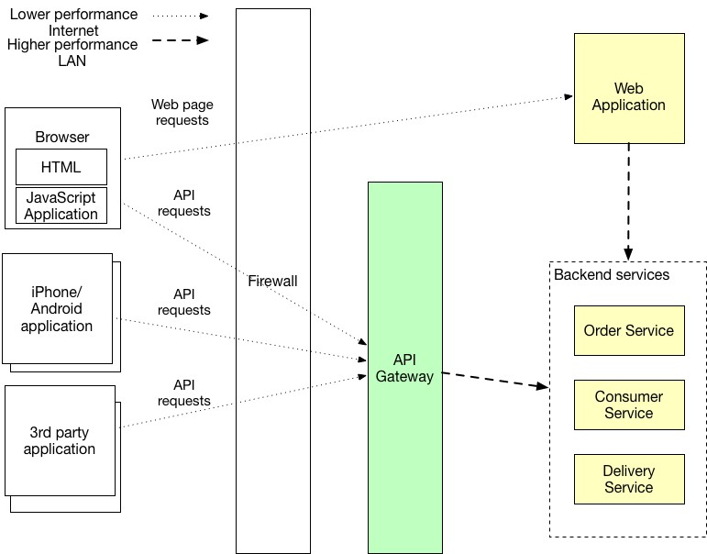
API Gateway

Slide 39
API Gateway
An API gateway is a service which is the entry point into the application from the outside world.
It’s responsible for request routing, API composition, and other functions, such as authentication.
The API gateway is responsible for request routing, API composition, and protocol translation.
All API requests from external clients first go to the API gateway.
The API gateway routes some requests to the appropriate service.

Slide 40
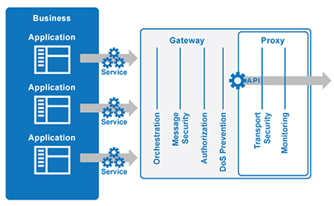
API Gateway
The gateway handles other requests using the API Composition pattern and invoking multiple services and aggregating the results.
It might also translate between client-friendly protocols such as HTTP and WebSockets and client-unfriendly protocols which are used by the services.

Slide 41
Request routing
One of the key functions of an API gateway is request routing.
An API gateway implements some API operations by routing requests to the corresponding service.
When it receives a request, the API gateway consults a routing map that specifies which service to route the request to.
A routing map might, for example, map an HTTP method and path to the HTTP URL of a service.
This function is identical to the reverse proxying features provided by web servers such as NGINX.

Slide 42
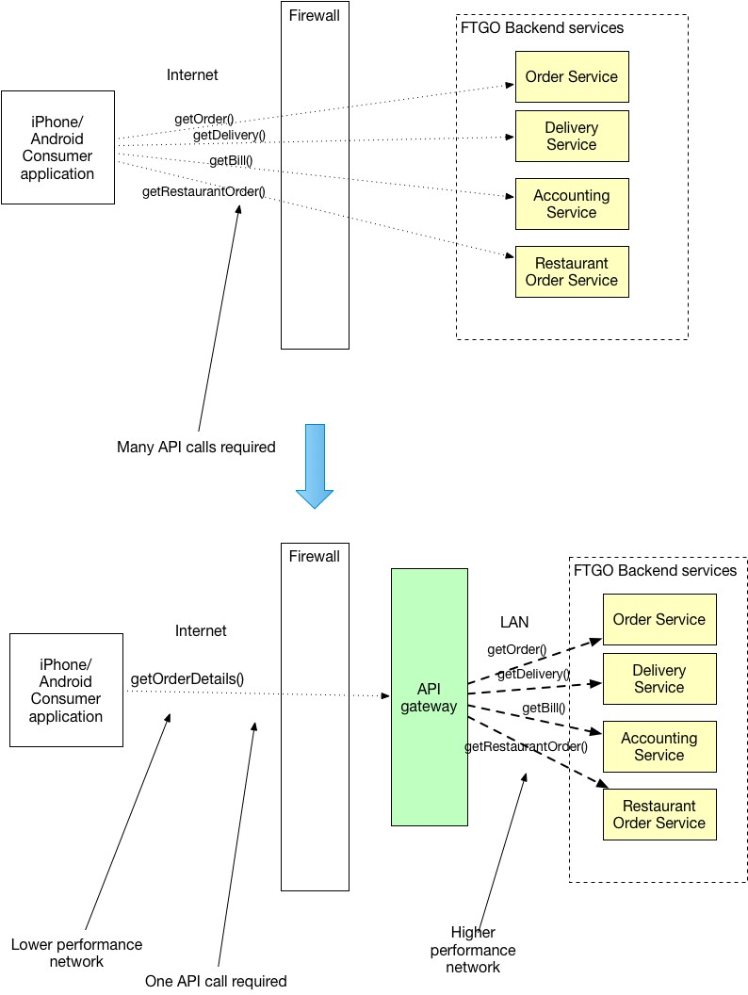
API Composition
An API gateway typically does more than reverse proxying.
It might also implement some API operations using API composition.
Multiple Requests? Can we have better model

Slide 43
API Composition

Slide 44
Protocol translation
An API gateway might also perform protocol translation.
The API gateway might provide a RESTful API to external clients even though the application services use a mixture of protocols internally include REST and gRPC.
When needed, the implementation of some API operations translate between the RESTful external API and the internal gRPC-based APIs.

Slide 45
API Proxy and Gateway

Slide 46
What is Apigee Edge?
Apigee Edge is a platform for developing and managing API proxies.
Think of a proxy as an abstraction layer that "fronts" for your backend service APIs and provides value-added features like security, rate limiting, quotas, analytics, and more.
The primary consumers of Edge API proxies are app developers who want to use your backend services.

Slide 47
Making your services available on the web
Companies today want to make their backend services available on the web so that these services can be consumed by apps running on mobile devices and desktops.
A company might want to expose services that provide product pricing and availability information, sales and ordering services, order tracking services, and any other services required by client apps.

Slide 48
Making your services available on the web
Companies often expose services as a set of HTTP endpoints. Client app developers then make HTTP requests to these endpoints.
Depending on the endpoint, the service might then return data, formatted as XML or JSON, back to the client app.

Slide 49
Making your services available on the web
The client apps that consume these services can be implemented as standalone apps for a mobile device or tablet, as HTML5 apps running in a browser, or as any other type of app that can make a request to an HTTP endpoint and consume any response data.
These apps might be developed and released by the same company that exposed the services, or by third-party app developers who make use of publicly available services.

Slide 50
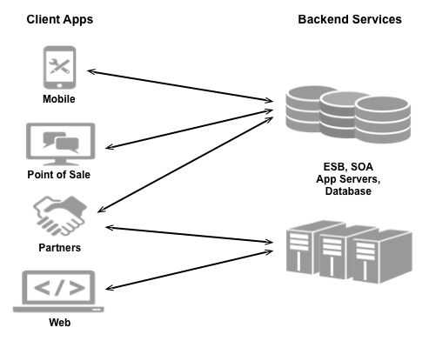
Making your services available on the web

Slide 51
Making your services available on the web
Because providers make their services available over the web, they must ensure that they have taken all necessary steps to secure and protect their services from unauthorized access. As a service provider, consider:
Security: How will you control access to your services to prevent unauthorized access?
Compatibility: Will your services work across different platforms and devices?
Measurability: How can you monitor your services to make sure they are available?
Monetization: How can you track and bill customers for access to your services?
And many other considerations

Slide 52
Making your services available on the web
After a client app has been released that accesses any services, the service provider is then required to make sure that those services continue to work over time as they add, modify, or delete those services.
The service provider must also have a way to keep app developers aware of any changes to the services to ensure that client apps stay in sync with those services.

Slide 53
Making your services available on the web
Client app developers face challenges when trying to consume services from different providers.
There are many technologies available today for use by a service provider to expose its services.
The same client app might have to use one mechanism to consume a service from one provider, and a different mechanism to consume a service from a different provider.
App developers can even face the situation where they have to use different mechanisms to consume services from the same provider.

Slide 54
Make services available through Apigee Edge
Apigee Edge, which is built on Java, enables you to provide secure access to your services with a well-defined API that is consistent across all of your services, regardless of service implementation. A consistent API:
Makes it easy for app developers to consume your services.
Enables you to change the backend service implementation without affecting the public API.
Enables you to take advantage of the analytics, monetization, developer portal, and other features built into Edge.

Slide 55
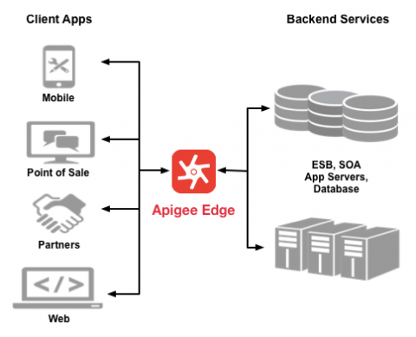
Make services available through Apigee Edge

Slide 56
Make services available through Apigee Edge
Rather than having app developers consume your services directly, they access an API proxy created on Edge.
The API proxy functions as a mapping of a publicly available HTTP endpoint to your backend service.
By creating an API proxy you let Edge handle the security and authorization tasks required to protect your services, as well as to analyze, monitor, and monetize those services.
Because app developers make HTTP requests to an API proxy, rather than directly to your services, developers do not need to know anything about the implementation of your services.
All the developer needs to know is:
The URL of the API proxy endpoint.
Any query parameters, headers, or body parameters passed in a request.
Any required authentication and authorization credentials.
The format of the response, including the response data format, such as XML or JSON.

Slide 57
Make services available through Apigee Edge
The API proxy isolates the app developer from your backend service.
Therefore you are free to change the service implementation as long as the public API remains consistent.
For example, you can change a database implementation, move your services to a new host, or make any other changes to the service implementation.
By maintaining a consistent frontend API, existing client apps will continue to work regardless of changes on the backend.

Slide 58
Make services available through Apigee Edge
You can use policies on the API proxy to add functionality to a service without having to make any changes to the backend service.
For example, you can add policies to your proxy to perform data transformations and filtering, add security, execute conditional logic or custom code, and to perform many other actions.
The important thing to remember is you implement policies on Edge, not on your backend server.

Slide 59
Understanding APIs and API proxies
Apigee Edge lets you easily and quickly build RESTful APIs that can be consumed by app developers.
You expose APIs on Edge by building API proxies that act as managed 'facades' for backend services.

Slide 60







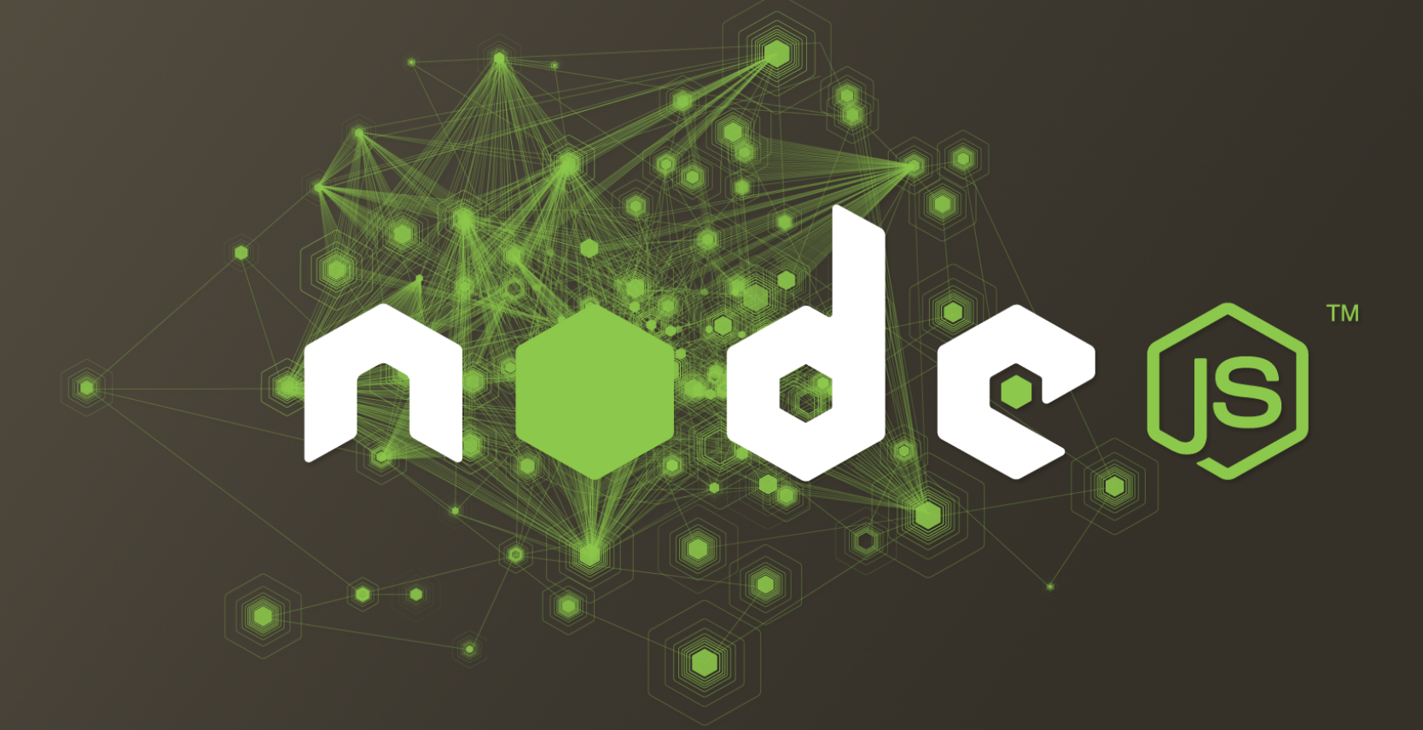

Apigee Edge – Overview of Capabilities
Developer Services
Developer Portal
Docs & Modeling
API Explorer
Monetization
API Team
Analytics Services
Developer Metrics
Ops Analytics
App Performance
App Usage
API Services
Backend
API Management
BaaS
Security
API Extensions

Slide 61
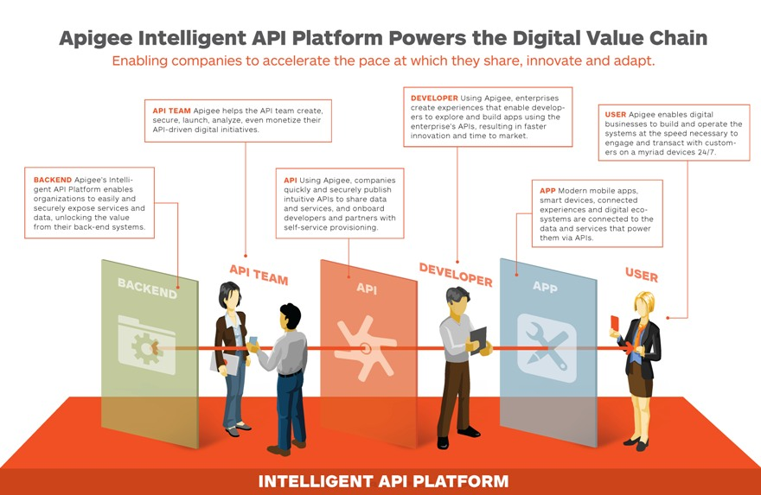
Apigee Edge – Overview of Capabilities

Slide 62
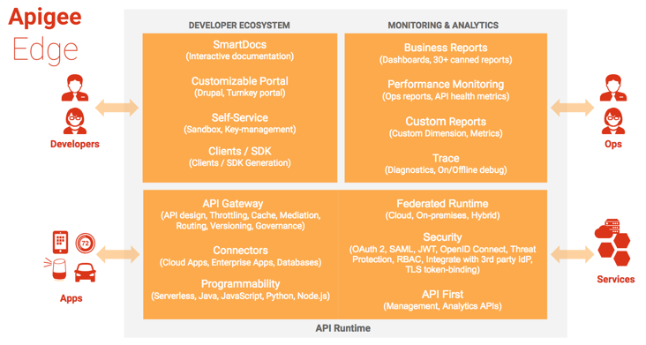
Components of Apigee Edge
Apigee Edge consists of API runtime, monitoring and analytics, and developer services that together provide a comprehensive infrastructure for API creation, security, management, and operations.

Slide 63
Edge API runtime
Apigee Edge API Services are all about creating and consuming APIs, whether you're building API proxies as a service provider or using APIs, SDKs, and other convenience services as an app developer.
On the API-building side, the API management server provides tools for adding and configuring your API proxies, setting up API products, and managing app developers and client apps.
It offloads many common management concerns from your backend services.
When you add an API proxy, you can apply policies to the API proxy for adding security, rate-limiting, mediation, caching, and so on.
You can also customize the behavior of your API proxy by applying custom scripts, making calls out to third-party APIs and services, and so on.

Slide 64
Edge API runtime
On the API-consuming side, API Services powers mobile and Web apps by giving app developers access to a flexible data store and to key features such as social graphs, geolocation, user management, push notifications, performance monitoring, and more.
These features, available with SDKs for iOS, Android, JavaScript, and others, let app developers focus on creating the rich features and user experience that truly differentiate a client app rather than burning time implementing core backend services and infrastructure.

Slide 65
Edge monitoring & analytics
Apigee Edge Analytics Services provides powerful tools to see short- and long-term usage trends of your APIs.
You can segment your audience by top developers and apps, understand usage by API method to know where to invest, and create custom reports on business- or operational-level information.

Slide 66
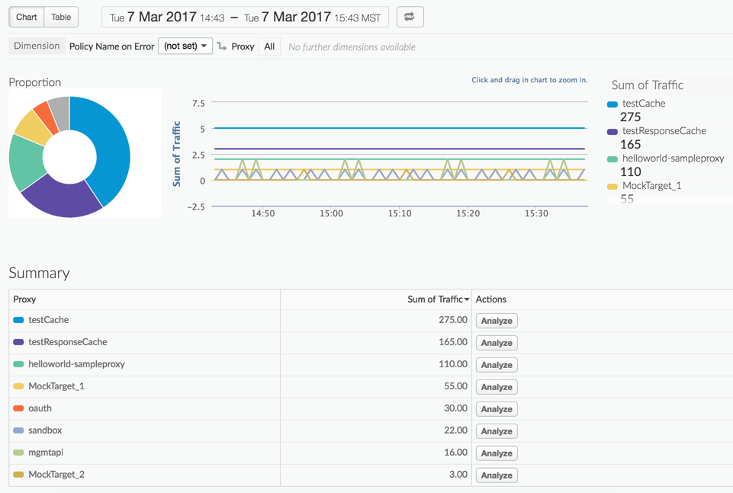
Edge monitoring & analytics
The management UI lets you view multiple metrics and dimensions in a browser, as shown in the following figure:

Slide 67
Edge developer ecosystem
Apigee Edge Developer Services provide the tools to manage the community of app developers using your services.
Developer Services offers the flexibility to work with internal and external developers and formalize these relationships with financial models.
Developer Services provides the ability to onboard developers and create a developer portal for your publicly available API products.
App developers connect to your portal to access API documentation, forums, and a blog.
Every Edge customer can create their own developer portal, either in the cloud or on-premises with Apigee Edge for Private Cloud.

Slide 68
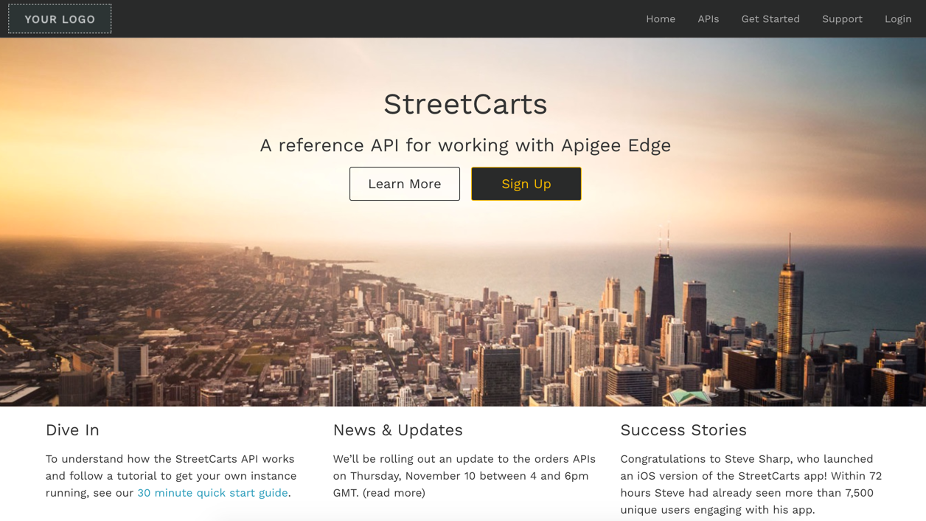
Edge developer ecosystem

Slide 69
Monetization
Monetization capabilities provide the financial infrastructure and relationships to turn your Developer community into an actual channel for your digital assets.
With monetization, you can create a variety of rate plans that charge developers for the use of your API products or let you pay developers in revenue-sharing scenarios.
Plans include pre-paid plans, post-paid plans, fixed-fee plans, variable rate plans, "freemium" plans, plans tailored to specific developers, plans covering groups of developers, and more. In addition, monetization includes reporting and billing facilities.

Slide 70
Edge in the cloud vs. Edge on-premises
You can install Edge on-premises (Apigee Edge for Private Cloud) in your own environment to retain complete control of the environment and of the deployment taxonomies.
Alternatively, you can use the cloud-hosted (SaaS) version where Apigee is responsible for maintaining the cloud environment for you, allowing you to concentrate on building your services and defining the API to those services.
The functionality between the two versions is virtually identical.
The difference is that the cloud supports both free and paid accounts, and that the hardware and software environment is managed by Apigee.

Slide 71
Edge in the cloud vs. Edge on-premises
With an on-premises installation, which requires a paid account, you are in complete control of Edge installation and deployment.
To fully support an on-premises installation, Edge includes components such as the Apigee management server, an Apache Cassandra NoSQL database, an OpenLDAP server, a message Router, and a Message Processor.

Slide 72
Edge in the cloud vs. Edge on-premises
Cloud service
On-premises
Developer Services
Developer Services
Our Cloud
Analytics Services
Analytics Services
Your
Data Center or Cloud
API Services
API Services
Your
Data Center
or Cloud
Existing Backend
Existing Backend
72

Slide 73
A word about organizations
To call an API proxy, includes your organization name and the environment (either "test" or "prod") in the URL:
https://your_org_name-[test|prod].apigee.net/path/to/resource
For example:
https://ahamilton-eval-test.apigee.net/getstarted
When you create a new account, your email is automatically added to the Organization Administrator role. That means you can do just about everything in your organization.

Slide 74
APIGEE
Step 2: Create an API proxy
Now that you've created your Apigee account, you're ready to create a simple API proxy.
To create an API proxy:
Open the Edge Management UI in a browser and log in.
Click API Proxies in the main window:

Slide 75
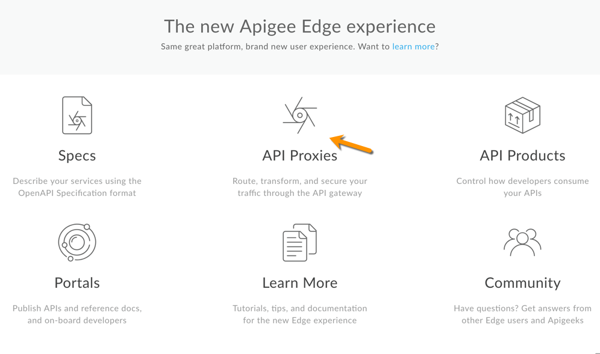
APIGEE

Slide 76
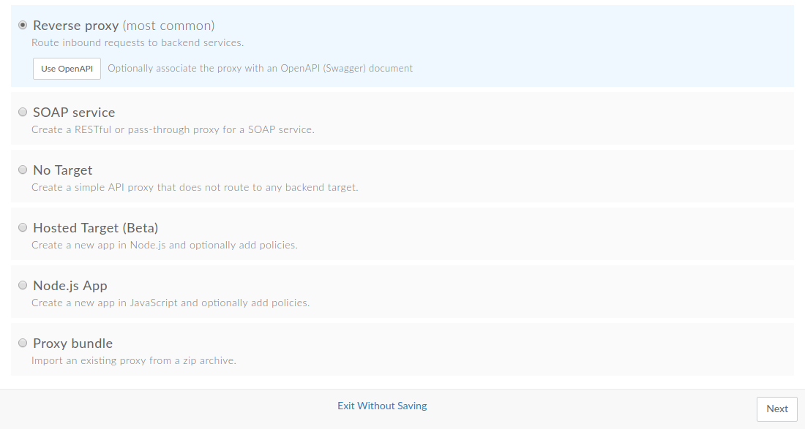
APIGEE
Click the add + Proxy button in the upper right:
Apigee walks you through the process of creating a new proxy. The first decision is the type of proxy:

Slide 77
What Is OpenAPI?
OpenAPI Specification (formerly Swagger Specification) is an API description format for REST APIs. An OpenAPI file allows you to describe your entire API, including:
Available endpoints (/users) and operations on each endpoint (GET /users, POST /users)
Operation parameters Input and output for each operation
Authentication methods
Contact information, license, terms of use and other information.
API specifications can be written in YAML or JSON.

Slide 78
What Is Swagger?
Swagger is a set of open-source tools built around the OpenAPI Specification that can help you design, build, document and consume REST APIs. The major Swagger tools include:
Swagger Editor – browser-based editor where you can write OpenAPI specs.
Swagger UI – renders OpenAPI specs as interactive API documentation.
Swagger Codegen – generates server stubs and client libraries from an OpenAPI spec.

Slide 79
Why Use OpenAPI?
The ability of APIs to describe their own structure is the root of all awesomeness in OpenAPI.
Once written, an OpenAPI specification and Swagger tools can drive your API development further in various ways:
Design-first users: use Swagger Codegen to generate a server stub for your API. The only thing left is to implement the server logic – and your API is ready to go live!
Use Swagger Codegen to generate client libraries for your API in over 40 languages.
Use Swagger UI to generate interactive API documentation that lets your users try out the API calls directly in the browser.
Use the spec to connect API-related tools to your API. For example, import the spec to SoapUI to create automated tests for your API.

Slide 80
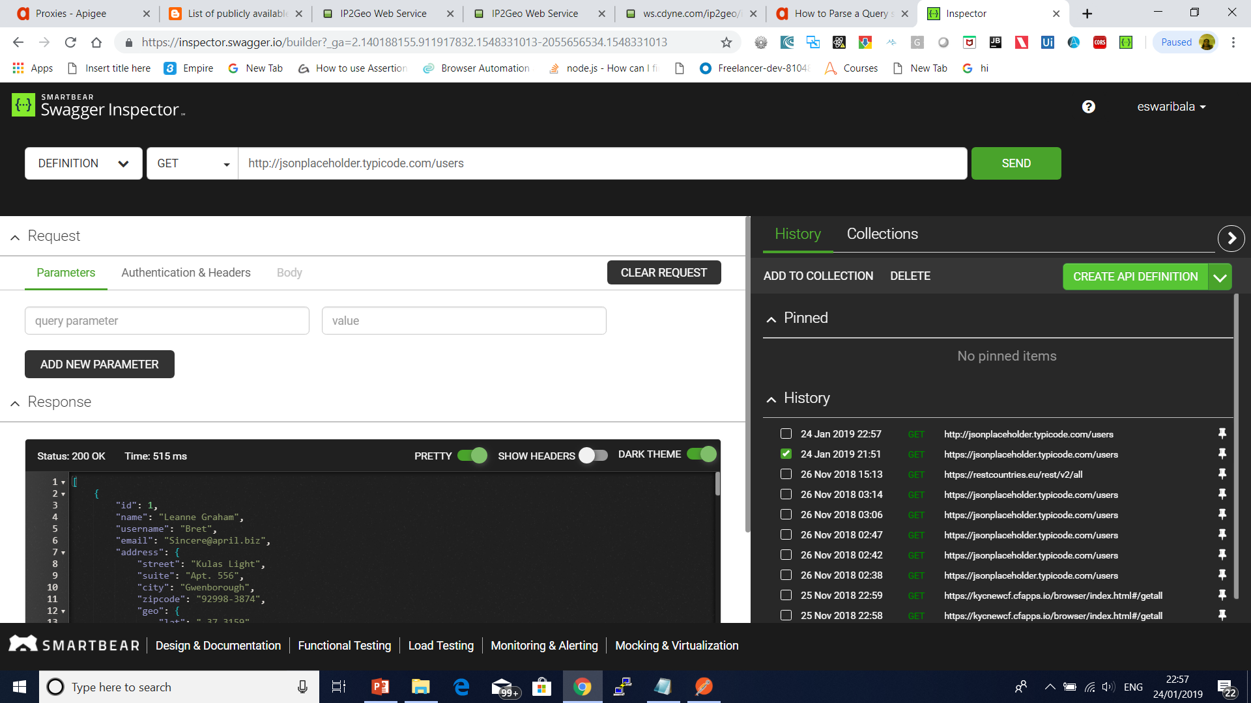

Slide 81
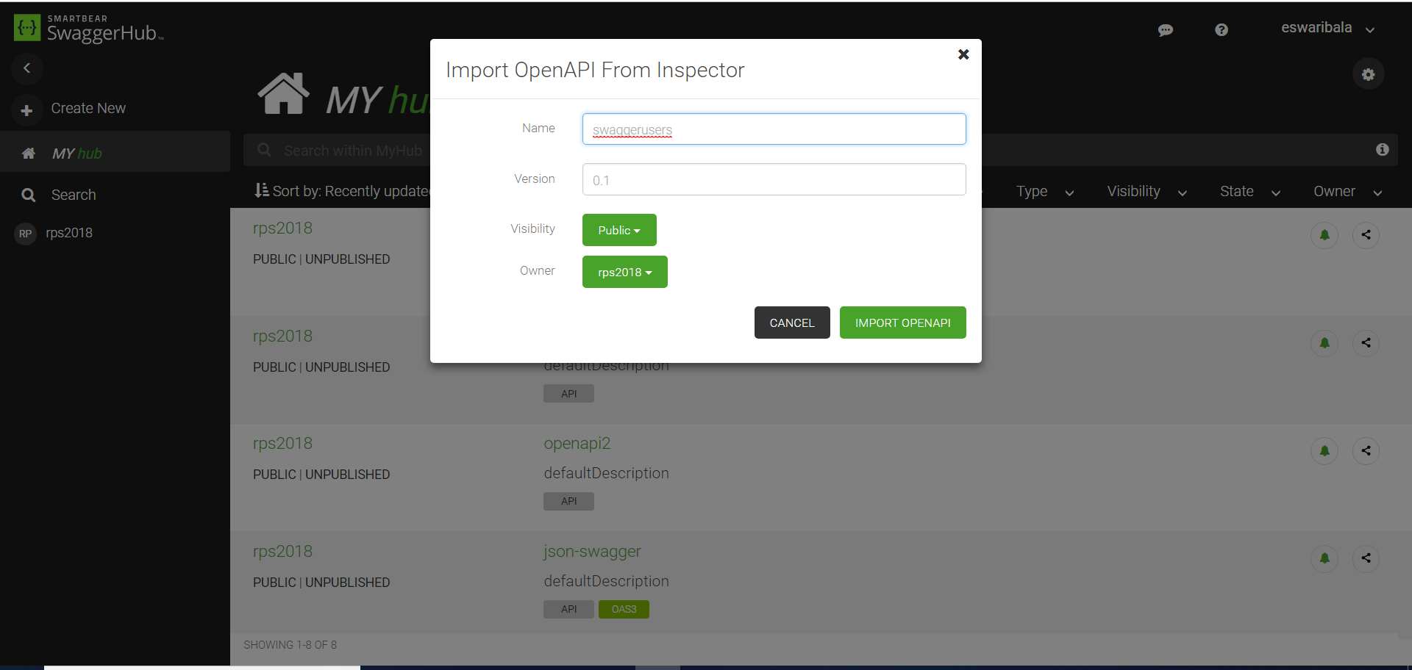

Slide 82
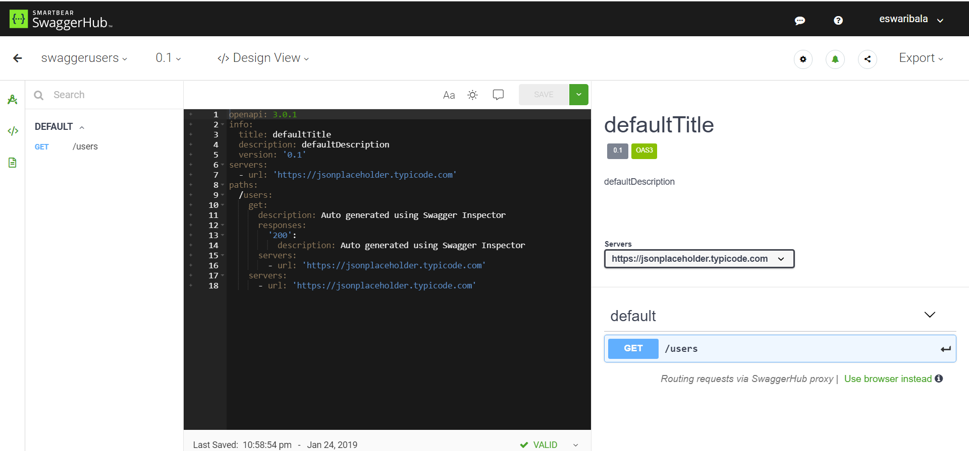

Slide 83
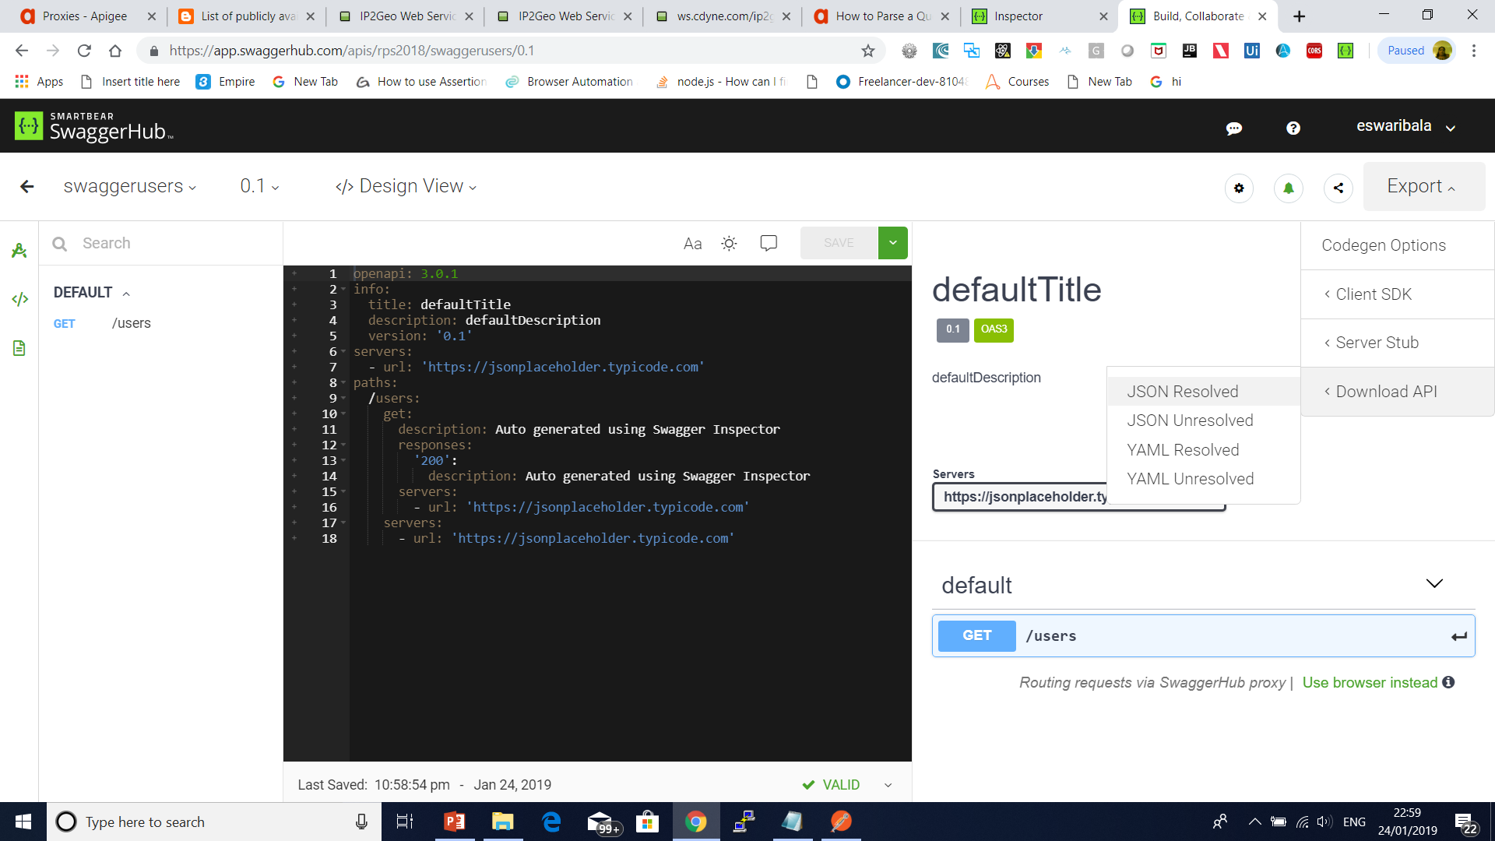

Slide 84
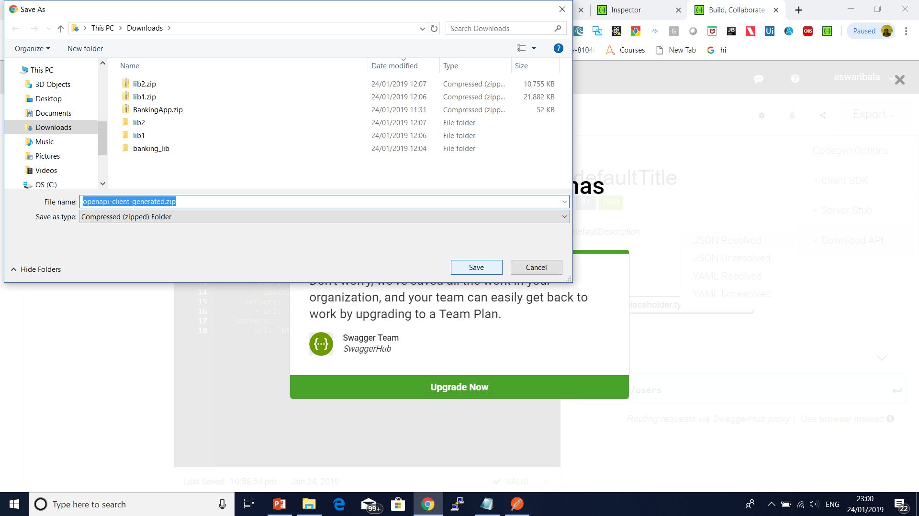

Slide 85
APIGEE
Select Reverse proxy (most common), and click Next.
Apigee then displays the Details screen.
Configure your proxy with the following settings:
Proxy Name: Enter "getstarted". If a proxy already exists with this name, choose a different name.
Proxy Base Path: Change this to "/getstarted".
The Proxy Base Path is part of the URL used to make requests to your API. Edge uses the URL to match and route incoming requests to the proper API proxy.

Slide 86
APIGEE
Existing API: Enter "https://mocktarget.apigee.net". This defines the target URL that Apigee Edge invokes on a request to the API proxy.
The mocktarget service is hosted at Apigee and returns simple data. It requires no API key or access token.
(Optional) Description: Enter a description for your new API proxy, such as "Getting Started proxy".

Slide 87
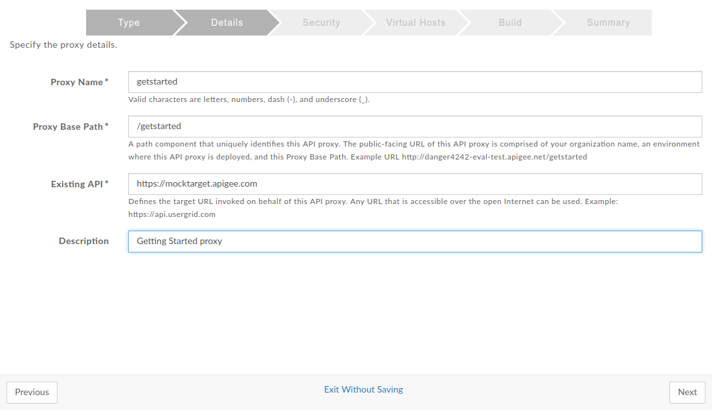
APIGEE

Slide 88
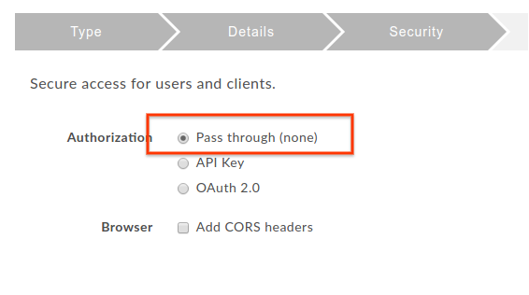
APIGEE
Click Next.
On the Security screen, select Pass through (none) as the security option, and click Next:

Slide 89
APIGEE
On the Virtual Hosts screen, accept the default selections and click Next.
On the Build screen, make sure the test environment is selected next to Deploy Environments and click Build and Deploy:

Slide 90
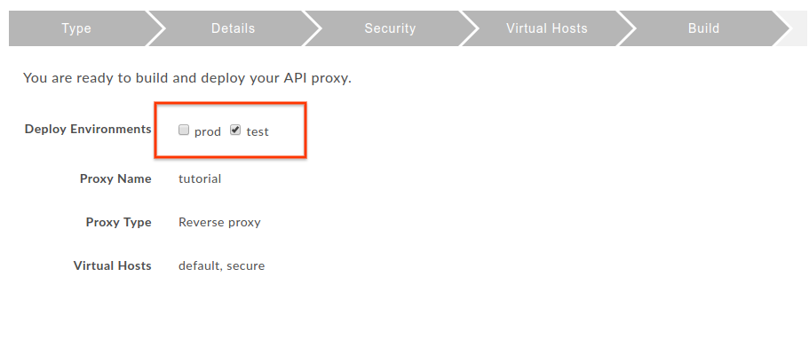
APIGEE

Slide 91
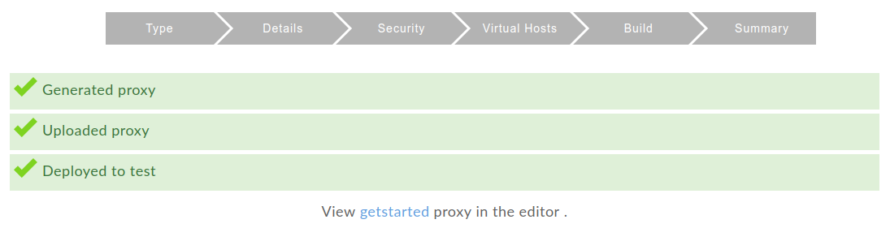
APIGEE

Slide 92
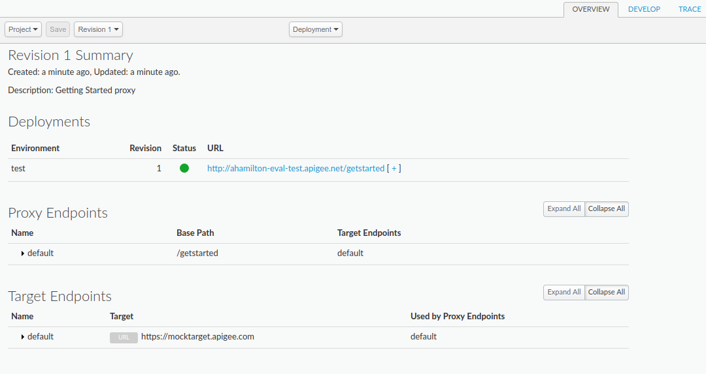
APIGEE
Click View getstarted proxy in the editor to display the Overview page for the API proxy:

Slide 93
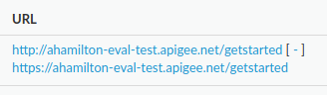
APIGEE
Note that if you expand the [ + ], the UI lists both HTTP and HTTPS URLs for the test environment:

Slide 94
APIGEE
Step 3: Test your new proxy
Now that you've created a new proxy, you're ready to test it.
You can test your "getstarted" API using curl or a web browser.
To test your new proxy:
In a terminal window, execute the following curl command:

Slide 95
APIGEE
curl https://org_name-test.apigee.net/getstarted
Where:
org_name is the organization name that Apigee assigned to you when you created your Apigee account.
-test is the environment. You deployed your new proxy to the "test" environment in Step 2: Create an API proxy.
/getstarted is the Proxy Base Path.

Slide 96
APIGEE
For example:
curl https://ahamilton-eval-test.apigee.net/getstarted
Alternatively, you can navigate to "https://org_name-test.apigee.net/getstarted" in a browser.
You should receive the following response:
Hello, Guest!

Slide 97
APIGEE
Step 4: Change your target endpoint
Now that you've tested your new proxy, you're almost ready to add a policy to it. Before you do that, though, you should change your proxy's target endpoint to one that returns some data.
Recall that in Step 2: Create an API proxy, you set the target endpoint (in the Existing API field) to "https://mocktarget.apigee.net". Well, that endpoint doesn't return any data, so now you'll change the endpoint to one that returns some XML.

Slide 98

APIGEE
To change your proxy's target endpoint:
Log in to the Edge Management UI and click API Proxies.
Select your getstarted proxy from the list. If you don't see your proxy in the list, be sure that you selected the right organization, as described in A word about organizations.

Slide 99
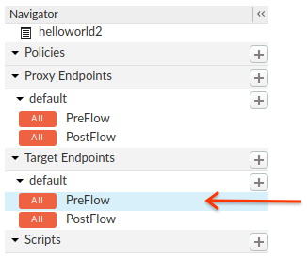
APIGEE
This takes you to the API Proxy Editor. The Proxy Editor lets you see the structure of your API proxy and configure its flow.
In the Navigator pane, select Target Endpoints > default:

Slide 100
APIGEE
<TargetEndpoint name="default">
<Description/>
<FaultRules/>
<PreFlow name="PreFlow">
<Request/>
<Response/>
</PreFlow>
<PostFlow name="PostFlow">
<Request/>
<Response/>
</PostFlow>
<Flows/>
<HTTPTargetConnection>
<Properties/>
<URL>https://mocktarget.apigee.net</URL>
</HTTPTargetConnection>
</TargetEndpoint>

Slide 101
APIGEE
Change the URL to "https://mocktarget.apigee.net/xml". (Append "/xml" to the existing URL.)
The new URL returns a small block of XML in the body of the response.
Your endpoint configuration should now look like the following:
...
<HTTPTargetConnection>
<Properties/>
<URL>https://mocktarget.apigee.net/xml</URL>
</HTTPTargetConnection>
...

Slide 102
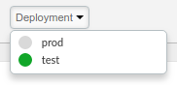
APIGEE
To save your changes to the proxy configuration, click the Save button.
Edge saves your changes and automatically deploys them.
If there is an error, Edge will save your changes but not deploy the proxy. In this case:
Fix your proxy configuration. Edge may provide syntax guidance as a pop-up.
Manually deploy your changes to the test environment by clicking Deployment > test if Edge does not automatically deploy it.
You can check if your proxy was deployed successfully by selecting the Deployment drop-down above the Flow editor. A green button indicates that the proxy was deployed to that environment successfully:

Slide 103
APIGEE
Test your changes by sending a request to your proxy, just like you did in Step 3: Test your new proxy. For example:
curl https://org_name-test.apigee.net/getstarted
For example:
curl https://ahamilton-eval-test.apigee.net/getstarted | xmllint --format -
This time, the mocktarget endpoint returns XML in the body of the response:

Slide 104
APIGEE
<?xml version="1.0" encoding="UTF-8"?>
<root>
<city>San Jose</city>
<firstName>John</firstName>
<lastName>Doe</lastName>
<state>CA</state>
</root>

Slide 105
APIGEE
Step 5: Add a policy
Now that you've changed your target endpoint, you're ready to add a policy to your proxy.
A policy is an Edge component that you can attach to different points in the message flow through your API proxies. Policies can transform message formats, enforce access control, call remote services, authorize users, examine message content for potential threats, and do much more.
We are going to add the XMLtoJSON policy to your proxy. This policy converts the payload of an XML message to JSON. It also changes the response's Content-Type header.

Slide 106
APIGEE
To add the XML to JSON policy to your proxy:
Open the Edge Management UI in a browser and log in.
Click API Proxies in the main window and select a proxy. For this example, select the proxy that you created in Step 2: Create an API proxy.
Click the Develop tab:

Slide 107
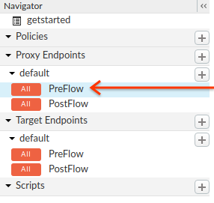
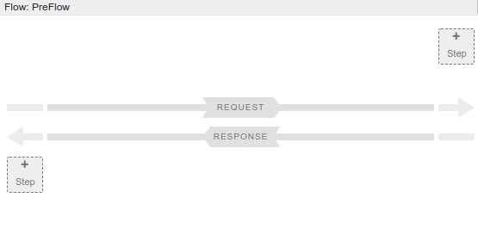
APIGEE
In the Navigator pane, click Proxy Endpoints > default > PreFlow:

Slide 108
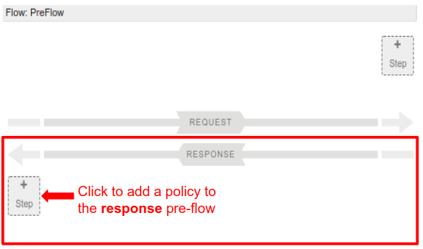
APIGEE
To add a policy to your proxy, click the + Step button in the response PreFlow (the bottom half of the Flow editor):

Slide 109
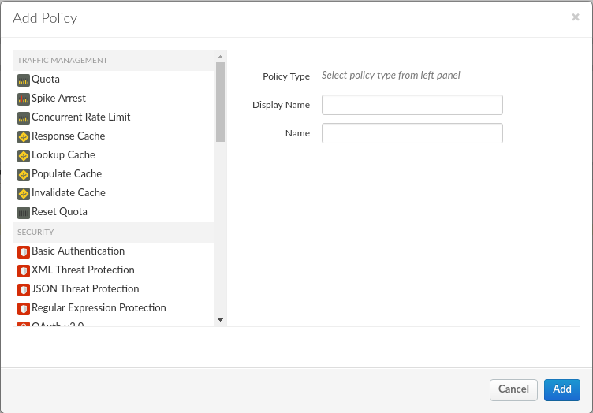
APIGEE
Edge displays a categorized list of policies in the Add dialog box that you can add to your flow:

Slide 110
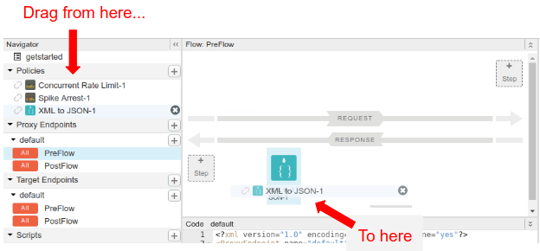
APIGEE
Scroll down and select the XML to JSON policy in the Mediation category.

Slide 111
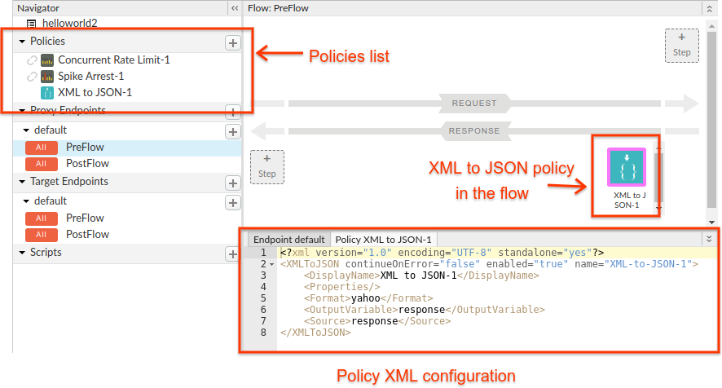
APIGEE
Leave the default names, and click Add.
Edge attaches the new policy to the PreFlow of the response:

Slide 112
APIGEE
Note that when you click Add, Edge does the following:
Adds the new policy under Policies in the Navigator pane.
Adds the XML to JSON policy in the Flow pane.
Displays the policy's configuration XML in the Code pane.
Click Save to save the current revision with your changes.
Now try it out! In a terminal window, execute the following curl command:

Slide 113
APIGEE
curl https://org_name-test.apigee.net/getstarted
Where:
org_name is the organization name that Apigee assigned to you when you created your Apigee account.
-test is the environment. You deployed your new proxy to the "test" environment in Step 2: Create an API proxy.
/getstarted is the Proxy Base Path.

Slide 114
SOAP Proxy
1. http://ws.cdyne.com/ip2geo/ip2geo.asmx?wsdl
2. create post method instead of GET
3. http://parameswaribala-eval-test.apigee.net/ip2geo/resolveip
4. create post query with raw json message
5. {
"ipAddress":"209.85.128.0",
"licenseKey":0
}

Slide 115
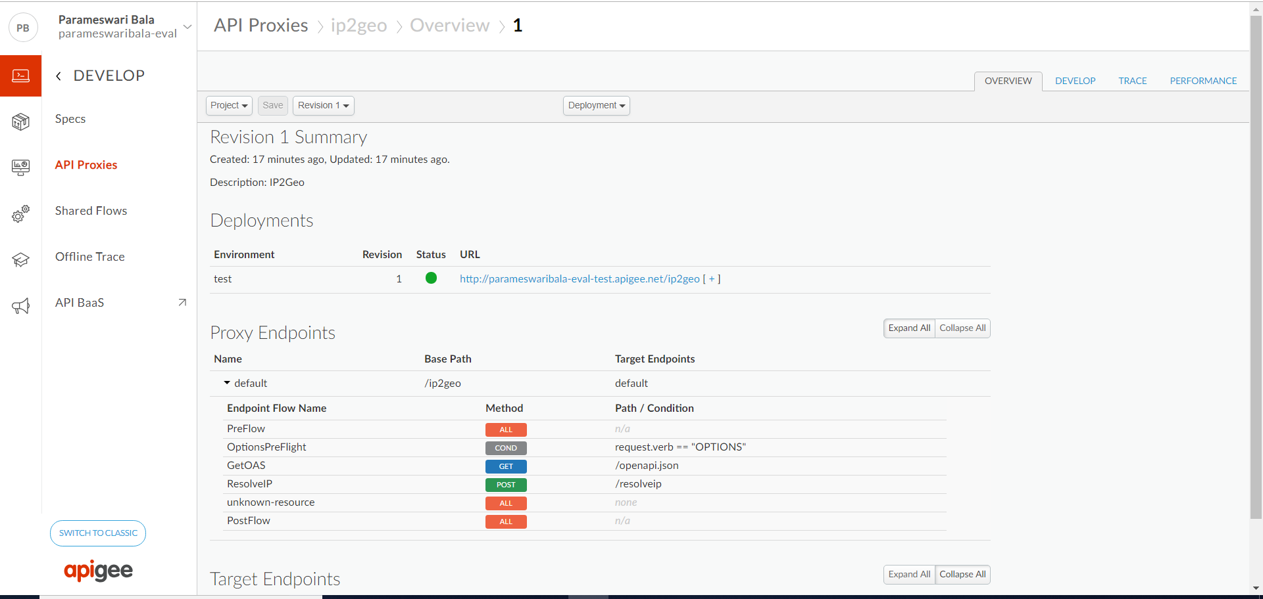
SOAP Proxy

Slide 116
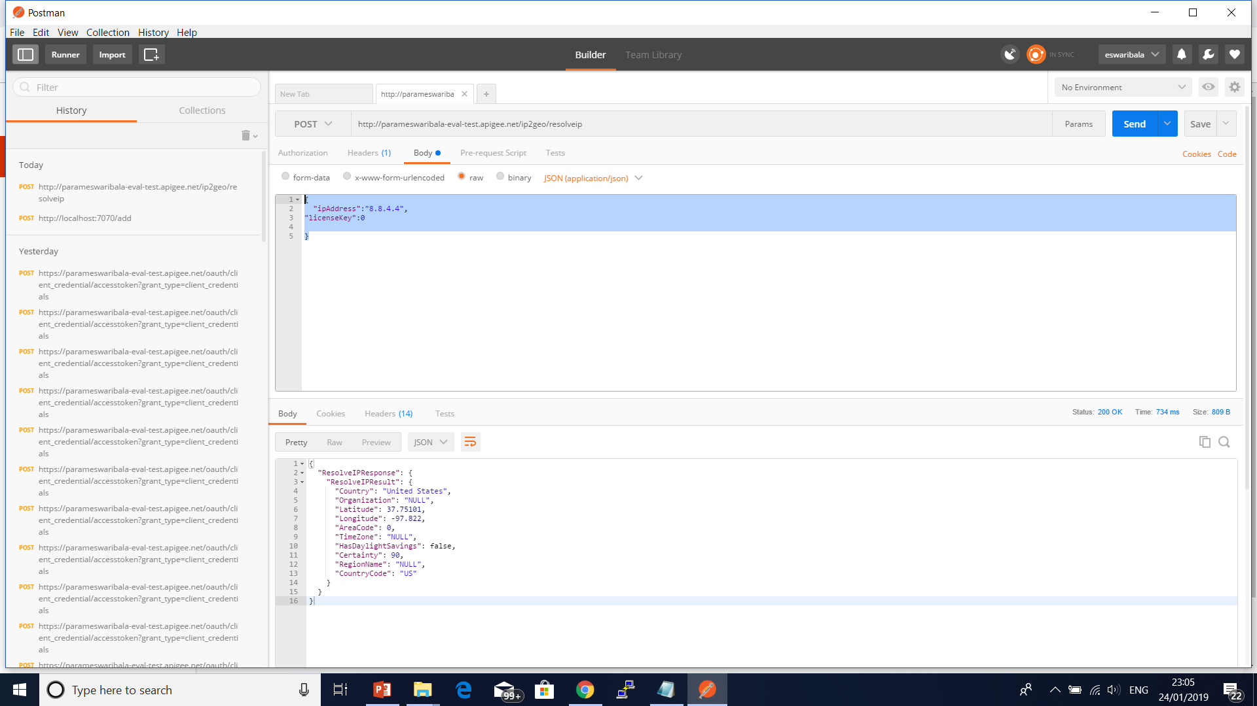
SOAP Proxy

Slide 117
No Target

Slide 118
Nodejs
apigeetool deploynodeapp -n myNodeApp -d . -m server.js -o myorg -e test -b /myNodeApp -u ntesla -p myPassword

Slide 119
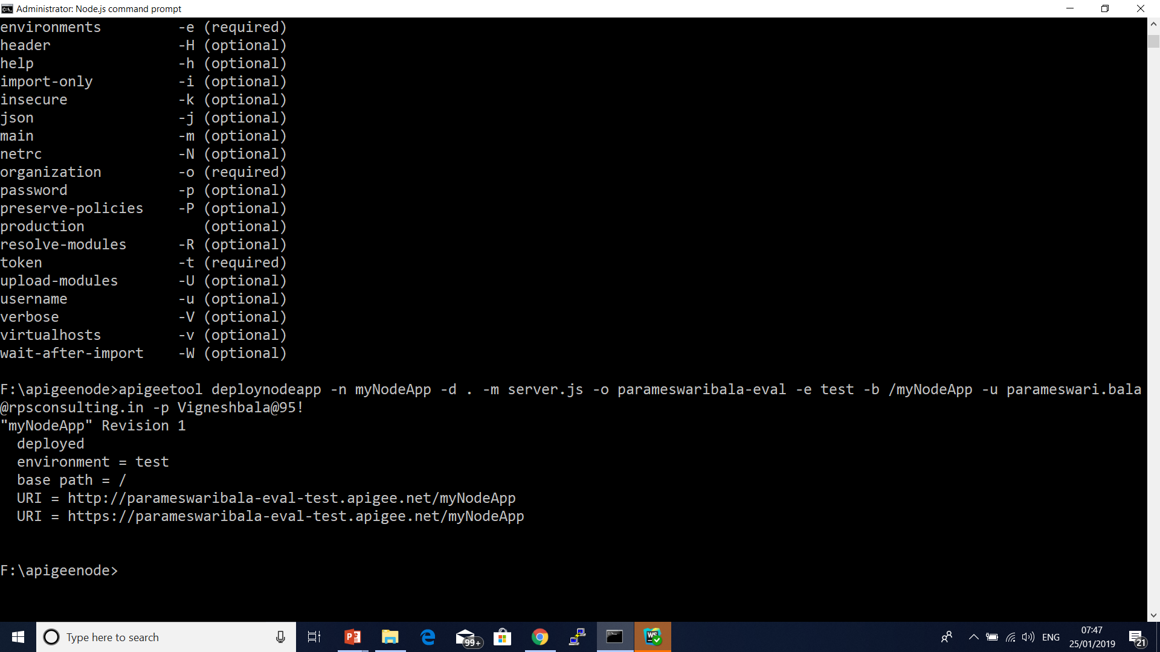
Nodejs

Slide 120
Download API proxies
Reasons to download an API proxy (as a zip file) from Edge:
You want to add the API proxy to another organization.
You want to unzip the API proxy to your local system. This is useful for setting up file-based API proxy development in source control, or for just looking at the file-based version of the resources. The extracted .zip creates the required directory structure for API proxy deployment.

Slide 121
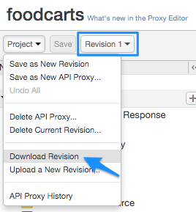
Download API proxies
Go to the API proxy editor Develop tab.
Select the proxy revision you want to download.
Select Project > Download Revision.

Slide 122
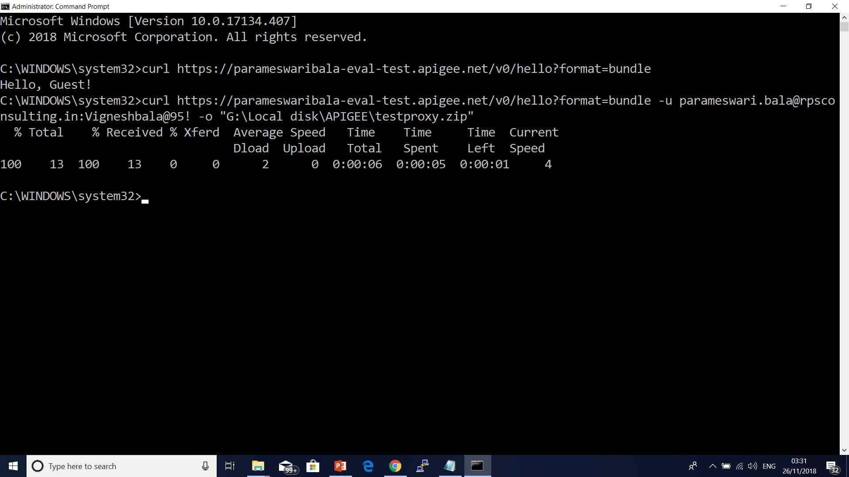
Export API Proxy
curl https://parameswaribala-eval-test.apigee.net/v0/hello?format=bundle
-u parameswari.bala@rpsconsulting.in:Vigneshbala@95! -o myProxy.zip

Slide 123
Secure an API by requiring API keys
Create an API proxy that requires an API key.
Add a developer and register an app.
Call your API with an API key.
It's important to protect your API from unauthorized access. One way to do that is with API keys (also called "public keys", "consumer keys" or "app keys").

Slide 124
Secure an API by requiring API keys
When an app makes a request to your API, the app must supply a valid key. At runtime, the Verify API Key policy checks that the supplied API key:
Is valid
Hasn't been revoked
Matches the API key for the API product that exposes the requested resources
If the key is valid, the request is allowed. If the key is invalid, the request results in an authorization failure.

Slide 125
Secure an API by requiring API keys

Slide 126

Secure an API by requiring API keys
Click + Proxy.
In the Build a Proxy wizard, select Reverse proxy (most common), and click Next.
Configure the proxy as follows:

Slide 127
Secure an API by requiring API keys
In this field | do this
Proxy Name | Enter: helloworld_apikey
Project Base Path | Change to: /helloapikey The Project Base Path is part of the URL used to make requests to the API proxy. Note: For Apigee's recommendations on API versioning, see Versioning in the Web API Design: The Missing Link e-book.
Existing API | Enter: http://mocktarget.apigee.net This defines the target URL that Apigee Edge invokes on a request to the API proxy.
Description | Enter: hello world protected by API key

Slide 128
Secure an API by requiring API keys
Click Next.
On the Security page:
In this field | do this
Authorization | Select the following options:API Key Publish API Product These options are very handy. They'll automatically add two policies to your API proxy and create an API product needed for generating the API key.

Slide 129
Secure an API by requiring API keys
On the Virtual Hosts page, click Next.
On the Build page, make sure the test deployment environment is selected, and click Build and Deploy.
On the Summary page, you see an acknowledgment that your new API proxy and an API product were created successfully, and that the API proxy was deployed to your test environment.
Click View the helloworld_apikey proxy in the editor to display the Overview page for the API proxy.

Slide 130
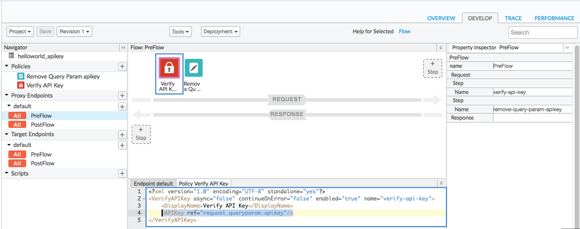
Secure an API by requiring API keys
View the policies

